Slide 2
COVID-19 Emergency Temporary Standard (ETS) Healthcare 29 CFR 1910.502
Employee Training Presentation
August 2021

Slide 3
Overview of COVID-19 ETS (29 CFR 1910.502)
As part of OSHA’s commitment to protect workers and deliver stronger worker safety protections, the agency has issued a COVID-19 Healthcare ETS that establishes new requirements to protect workers from exposure to COVID-19 in all settings, with some exceptions, where any employee provides healthcare or healthcare support services.
Stony Brook has reviewed its established practices and created a compliance plan for compliance with the ETS, combining references to postings on ThePulse and other modes of communication employed during this period.
Continued

Slide 4
SBUH developed a robust online training module at the onset of the pandemic on the plan to keep employees healthy and safe throughout the COVID-19 pandemic. This educational model was assigned to all SBUH employees. In addition, and in accordance with a recent NY State directive, all employees were required to read health and safety protocols related to COVID-19 and affirm they will adhere to them. Ongoing education is delivered to employees in various forums, which include but are not limited to staff meetings, daily huddles, email blasts, and the hospital intranet.

Slide 5
The ETS requires employers to:
Conduct a hazard assessment and implement a COVID-19 plan for each workplace. Engage employees in the development of the plan.
The hazard assessment was conducted and lead by Healthcare Epidemiology and other task groups at SBUH.
Human Resources has worked with employee representatives.
Multiple SBUH committees had provided input on SBUH’s COVID response plans.

Slide 6
Risk assessments are conducted regularly in multiple contexts, and standard operating procedures are revised as necessary. The staff has been provided with and required to use appropriate Personal Protective Equipment (e.g., respiratory protection, eye protection, gloves, gowns). Hand hygiene practices have been highlighted, and hand sanitizer has been distributed throughout the hospital. Significant efforts have been expended on source control (masking) of staff, visitors, and patients. Social distancing had been maintained where possible. Modifications to facilities (e.g., signage, HVAC operation changes, use of barriers, etc.) have been implemented.

Slide 7
COVID ETS
Workplace Safety Coordinator
OSHA requires designation of a workplace safety coordinator, knowledgeable in infection control principles and practices, with authority to implement, monitor, and ensure compliance with the plan.
Jennifer Maxwell
Director of Healthcare Epidemiology
Level 1 Hospital Rm 716
631 444 2646

Slide 8
COVID-19 Plan
SBUH developed the required written plan.
SBUH has designated a workplace safety coordinator to implement and monitor the plan and ensure compliance with all aspects of the COVID-19 plan.
SBUH has solicited input from employees, including non-managerial employees, through various committee and work group and HR has worked with employee representatives.
SBUH must monitors the workplace to ensure the ongoing effectiveness of the COVID-19 plan and update it as needed. Monitoring occurs at Morning Huddle, HICS calls, and reports from Employee Health & Wellness (EH&W) and Infection Prevention.
Continued

Slide 9
COVID-19 Plan
The COVID-19 plan addresses the hazards identified by the hazard assessment and include policies and procedures to minimize the risk of transmission of COVID-19 for each employee, including:
Patient screening and management
Standard and Transmission-Based Precautions
Personal Protective Equipment (PPE)
Aerosol-generating procedures on a person with suspected or confirmed COVID-19
Physical distancing
Physical barriers
Cleaning and disinfection
Ventilation
Health screening and medical management
Vaccination
Training

Slide 10
This SBUH COVID ETS plan was written to comply with OSHA’s Emergency Temporary Standard [29 CFR 1910.502 et seq] and to reflect the extensive measures Stony Brook University Hospital (SBUH) has implemented to protect patients, staff, and visitors throughout the pandemic.
The normal modes of policies, standard operating procedures, communication, and education that Stony Brook University Hospital successfully has employed throughout the pandemic are the primary source of information for staff and are more timely than the snapshot provided by this document. Such traditional communication, education, policies, and standard operating procedures take precedence over the statements provided in this working plan.

Slide 11

COVID

Slide 12
COVID-19 Transmission
COVID-19, or coronavirus disease 2019, is the respiratory disease caused by the virus SARS-CoV-2.
The virus that causes COVID-19 spreads most commonly through person-to-person contact (within about 6 feet of each other), primarily through the inhalation of respiratory particles (droplets and aerosols) produced when an infected person exhales, talks, sings, shouts, coughs or sneezes.
An infected person can spread the virus before they show symptoms (pre-symptomatic) or without ever showing symptoms (asymptomatic).
Less commonly, the virus spreads over longer distances when smaller droplets or particles linger in the air, particularly in indoor settings with inadequate ventilation.
Another less common way the virus can spread is when someone touches a contaminated surface and then touches their nose, mouth or eyes.

Slide 13
Signs and Symptoms of COVID-19
COVID-19 symptoms can include:
Fever or chills
New loss of taste or smell
Cough
Sore throat
Shortness of breath or difficulty breathing
Congestion or runny nose
Fatigue
Nausea or vomiting
Muscle or body aches
Diarrhea
Headache
Continued

Slide 14
Signs and Symptoms of COVID-19
If you are sick:
Notify your employer (EH&W or follow directions from CampusClear), stay at home and isolate yourself from others.
Contact your local healthcare provider and get tested if you have symptoms of COVID-19.
Call 911 if you are experiencing trouble breathing, or pain/pressure in the chest.

Slide 15
Risk Factors for Severe Illness
Severe illness means that a person with COVID-19 may need hospitalization, intensive care, a ventilator to help them breathe or they may even die. Risk factors* for severe illness can include:
Older adults
Pregnant people
Cancer
Chronic kidney disease
Chronic lung diseases (e.g., COPD, asthma, etc.)
Dementia or other neurological conditions
Diabetes
Down syndrome
Heart conditions
HIV infection
Immunocompromised state
Liver disease
Overweight and obesity
Pregnancy
Sick cell disease
Smoking, current or former
Solid organ or blood stem cell transplant
Stroke or cerebrovascular disease
Substance use disorders
*www.cdc.gov/coronavirus/2019-ncov/need-extra-precautions/people-with-medical-conditions.html

Slide 16
When to Seek Medical Care
Seek emergency medical care immediately (call 911) if you or someone else is having:
Trouble breathing
Persistent pain or pressure in the chest
New confusion
Inability to wake or stay awake
Pale, gray, or blue-colored skin, lips, or nail beds, depending on skin tone
These are not all possible symptoms. Call your medical provider for any other symptoms that are severe or concerning to you.

Slide 17
Facemasks
The employer must provide, and ensure employees wear, facemasks when indoors and when occupying a vehicle with other people for work purposes.
Facemasks must be:
Cleared by the Food and Drug Administration (FDA), authorized by an FDA Emergency Use Authorization (EUA) or otherwise offered or distributed as described in an FDA enforcement policy.
Worn by each employee over the nose and mouth.
Changed at least once per day, whenever they are soiled or damaged, and more frequently as necessary (e.g., patient care reasons).
SBUH provides compliant face masks for all employees, and requires use subject to public health guidance.

Slide 18
Facemasks
August 4 - Revised Mask Guidance
Throughout All Stony Brook Medicine Buildings
As a follow-up to the email message that was sent from University officials on Monday, August 2, we want to remind all faculty and staff that effective immediately we are requiring that everyone, regardless of their vaccination status, must wear face masks when inside all Stony Brook Medicine buildings.

Slide 19
Facemasks
This facemask requirement includes the Health Sciences and Basic Sciences Towers, offices in Flowerfield, Tech Park, Ronkonkoma and Commack, and administrative areas within outpatient facilities and physician practices where mask restrictions were previously lifted. The mask guidance for inside the hospital and all patient-care areas has not changed where masks are still required for everyone.
NOTE: If you work in an office located in the hospital with another person, regardless of your vaccination status, you must wear a mask or remain at least 6 feet apart. If you are alone in your office, you do not need to be masked.

Slide 20
Facemasks
Limitations of facemasks:
Facemasks are not substitutes for other policies and procedures to protect against COVID-19 and must be worn in addition to physical distancing and other precautions.
Facemasks can become soiled after each use and may be contaminated with bacteria and viruses, including the virus that causes COVID-19. This is why it is important to replace facemasks at least daily, and whenever they become damaged or soiled, and more frequently as necessary (e.g., patient care reasons).

Slide 21
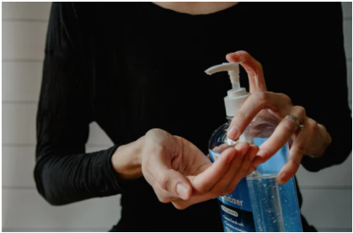
Hand Hygiene

Slide 22
Hand Hygiene
Regular handwashing is one of the best ways to remove germs, avoid getting sick and prevent the spread of COVID-19 to others.
To properly wash hands:
Wet hands with water.
Apply enough soap to cover all hand surfaces.
Rub hands together and scrub everywhere.
Wash the front and back of your hands, in between your fingers, and under your nails.
Rinse hands with water.
Dry hands completely using a single-use towel or air dry.
Wash hands before eating; after blowing your nose, coughing, sneezing, being in a public place, using the bathroom, touching an animal or handling waste; before and after caring for someone who is sick; and before, during and after preparing food.
Use an alcohol-based hand rub if soap and water are not available.

Slide 23
Respiratory Etiquette
Practice good respiratory etiquette to reduce the risk of spreading COVID-19:
Cover you mouth and nose with a tissue when coughing or sneezing to prevent the spread of germs.
Throw used tissues in the trash.
If you don’t have a tissue, cough or sneeze into your elbow, not your hands.
Remember to wash your hands immediately after blowing your nose, coughing or sneezing.

Slide 24
Health Screening, Medical Management, and Contact Tracing
Under the ETS, the employer must screen each employee before each workday and each shift for COVID-19 symptoms. If testing is required for screening purposes, it must be provided by the employer, at no charge to the employee.
Employees must notify their employer when they:
Have tested positive for COVID-19 or been diagnosed with COVID-19 by a licensed healthcare provider;
Have been told by a licensed healthcare provider they are suspected to have COVID-19;
SBUH uses CampusClear to screen employees and collect exposure information on a daily basis. Additionally all hospital employees are required to comply with a testing protocol. SBUH also conducts appropriate contact tracing, in compliance with State and Local directives.

Slide 25
Campus Clear Screening App
CampusClear App
All Stony Brook University Hospital employees are required to use the CampusClear app to self-screen for COVID-19 symptoms each workday.
The CampusClear application offers greater flexibility as it can be downloaded to your mobile device as an app and accessed via your web browser. CampusClear is the same easy-to-use app that students and West Campus are successfully using. Each day from your phone, you simply click the app and answer the questions. Once submitted, you and your supervisor will be able to view the “My Health Log” which demonstrates your compliance with daily screening.
Note: CampusClear will not impact the SOLAR Supervisor Report – the COVID-19 SOLAR Supervisor Report will continue to update as usual.
https://inside.stonybrookmedicine.edu/Campus_Clear_Screening_App

Slide 26
Screening Patients, Contractors, and Visitors
In settings where direct patient care is provided, SBUH:
Limits and monitors points of entry to the setting;
Screens and triages all clients, patients, residents, delivery people, visitors, and other non-employees entering the setting for symptoms of COVID-19;
Implements other applicable patient management strategies in accordance with the CDC’s “COVID-19 Infection Prevention and Control Recommendations”; and
Continued

Slide 27
Employer Notification of Illness
SBUH requires employees to promptly notify their Supervisor and EH&W when they have tested positive for COVID-19 or been diagnosed with COVID-19 by a licensed healthcare provider, have been told by a licensed healthcare provider that they are suspected of having COVID-19, are experiencing any new signs, and symptoms of COVID-19 which include recent loss of taste and/or smell with no other explanation, a fever (≥100.4° F), new cough, shortness of breath, sore throat, fatigue, muscle or body aches, headache, congestion or runny nose, nausea, vomiting or diarrhea.
This is also a part of the Campus Clear Screening app.

Slide 28
Employer Notification to Employees of COVID-19 Exposure in the Workplace
SBUH notifies employees if they have been exposed to a person with COVID-19 at their workplace. The notification provisions below are not triggered by the presence of a patient with confirmed COVID-19 in a workplace where services are normally provided to suspected or confirmed COVID-19 patients (e.g., emergency rooms, urgent care facilities, COVID-19 testing sites, COVID-19 wards in hospitals).

Slide 29
When SBUH is notified that a person who has been in the workplace (including employees, clients, patients, residents, vendors, contractors, customers, delivery people, and other visitors, or other non-employees) is COVID-19 positive, SBUH will, within 24 hours:
Notify each employee who was not wearing a respirator and any other required PPE and has been in close contact with the person with COVID-19 in the workplace. The notification must state the fact that the employee was in close contact with someone with COVID-19 along with the date(s) the contact occurred.
Notify all other employees who were not wearing a respirator and any other required PPE and worked in a well-defined portion of a workplace (e.g., a particular floor) in which the person with COVID-19 was present during the potential transmission period. The notification must specify the date(s) the person with COVID-19 was in the workplace during the potential transmission period.

Slide 30
Notify other employers whose employees were not wearing a respirator and any other required PPE and have been in close contact with the person with COVID-19 or worked in a well-defined portion of a workplace (e.g., a particular floor) in which that person was present during the potential transmission period. The notification must specify the date(s) the person with COVID-19 was in the workplace during the potential transmission period and the location(s) where the person with COVID-19 was in the workplace.
SBUH conducts appropriate contact tracing.

Slide 31
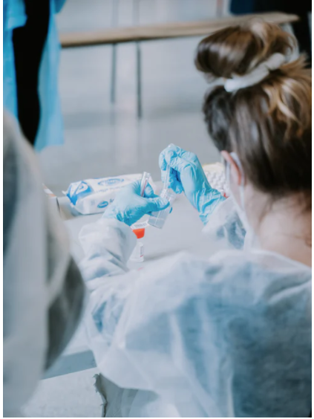
Employee
COVID Surveillance Testing
All Stony Brook University Hospital staff, FSA hospital colleagues and School of Medicine clinical faculty are required to participate in weekly anterior nasal swab (ANS) COVID surveillance testing in the Health Sciences Galleria on Level 3.
https://inside.stonybrookmedicine.edu/Coronavirus/Anterior_Nasal_Swab_Testing

Slide 32
COVID-19 Testing for Staff
Post-Exposure
In-house COVID-19 testing is available in Employee Health & Wellness for fully vaccinated employees who may have been exposed to COVID and who are not experiencing COVID symptoms. Please review the guidelines below for the steps to follow in these various situations.

Slide 33
1. Fully Vaccinated Employees Who Have Been Exposed but Do Not Have Symptoms
Employees who have been exposed to a confirmed or suspected case of COVID-19, who also have been fully vaccinated (two weeks after the final COVID vaccination) and have no symptoms:
You may go to work.
Please call Employee Health & Wellness at (631) 444-7767 to schedule an appointment for testing within 24 hours of learning about the exposure. At that time, Employee Health will provide guidance if any additional testing is required.

Slide 34
2. Unvaccinated Employees Who Have Been Exposed but Do Not Have Symptoms
Employees who have not been fully vaccinated and have been exposed to a confirmed or suspected case of COVID-19:
Please do not go to work.
Employees must call Employee Health at (631) 444-7767 for guidance on dates to quarantine and stay home from work.

Slide 35
3. Any Employee Who Has Symptoms Regardless of Vaccination Status
Employees who have developed any symptoms of COVID (i.e., fever or chills, cough, shortness of breath or difficulty breathing, fatigue, muscle or body aches, headache, new loss of taste or smell, sore throat, congestion or runny nose, nausea or vomiting, or diarrhea):
Please do not go to work.
Employees must call Employee Health at (631) 444-7767 and should also get tested through their private physician.
If you are having serious life-threatening symptoms, please go to the Emergency Department for evaluation.

Slide 36
Medical Removal Protection Benefits
Under the ETS, employers with more than 10 employees on the date the ETS became effective must provide medical removal protection benefits to removed employees.
SBUH complies with instruction on medical removal protection and other benefits from the Governor’s Office of Employee Relations. GOER Guidelines are complaint with the OSHA ETS.
Additional information can be obtained on the Human Resources website or COVID-19 Health Guidance and Return to Work Tool from https://inside.stonybrookmedicine.edu/Coronavirus_what_you_need_to_know
Per OSHA, if remote work is available, the employer may require the removed employee to perform remote work and must continue to pay them the same regular pay and benefits until they meet the return-to-work criteria.

Slide 37
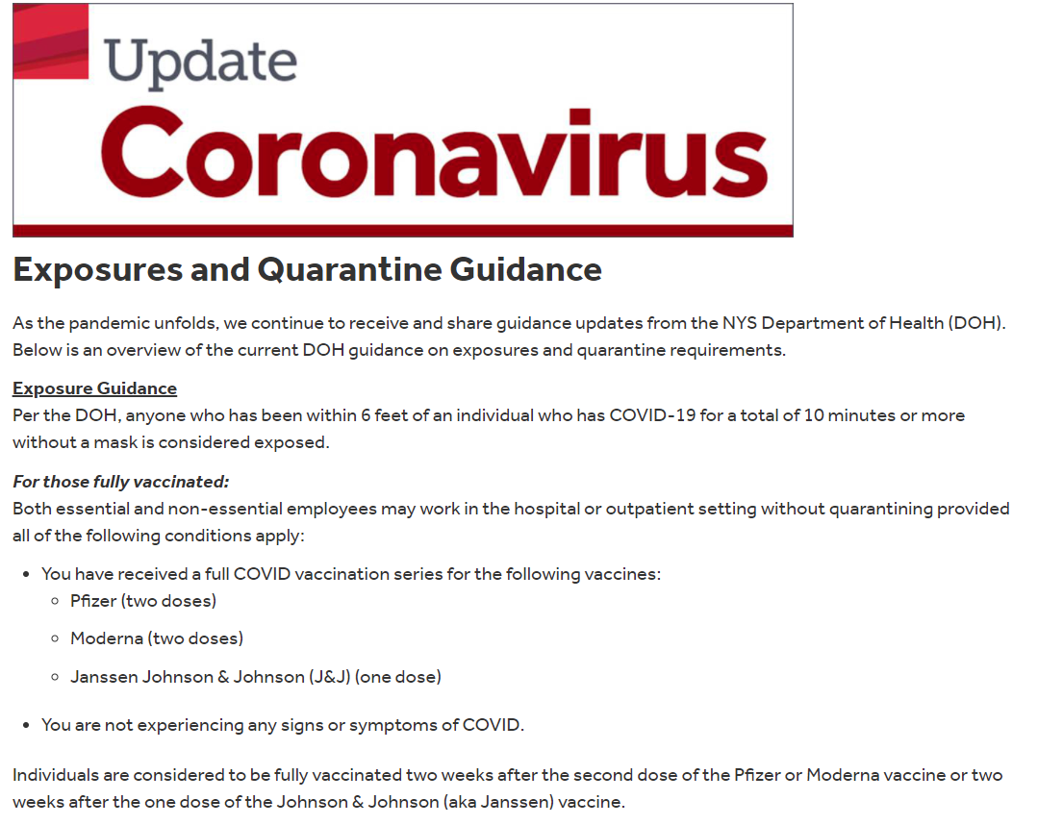

Slide 38
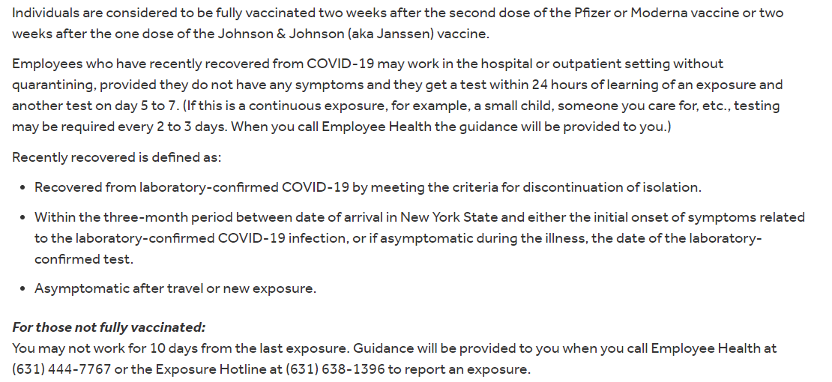
https://inside.stonybrookmedicine.edu/Coronavirus/Exposure_Quarantine_Restrictions

Slide 39
Vaccination
SBUH will comply with NYS Department of Health and NYS Governor’s mandate for vaccination.
Additional information is pending. Please see ThePulse.
Vaccines are offered in the workplace at a reasonable time and place. Policies address leaves for vaccination or vaccine related side effects consistent with GOER direction.

Slide 40
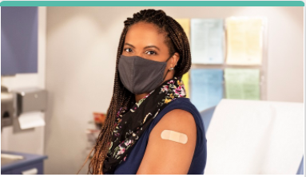
The Pulse – 8/2/2021
Vaccination Status Reporting
Per NYS Department of Health guidelines: “All healthcare facilities are expected to know which of their staff have been vaccinated. Any vaccinated staff who did not receive the vaccine through their workplace must inform the facility of their vaccination status through the same process the facility uses to maintain information on annual influenza immunizations and tuberculosis tests.”
Detail of disclosure can be found on ThePulse.
Please refer to ThePulse for latest requirements

Slide 41
ID Badge Stickers
All employees who have been fully vaccinated are required have a COVID vaccine sticker placed on their employee ID badge. Similar to our flu vaccine stickers, the COVID vaccine stickers will enable easy identification of those who have been vaccinated to help ensure compliance with the latest CDC and DOH guidance.
Please see ThePulse for additional info.

Slide 42
Standard and Transmission-Based Precautions
SBUH develops and implements policies and procedures to adhere to Standard and Transmission-Based Precautions in accordance with CDC’s “Guidelines for Isolation Precautions.” Please refer to the Healthcare Epidemiology’s COVID-19 Infection Prevention and Control Plan 2021. See IC0012 Standard Precautions; see also:
IC0006 Isolation Precautions
IC0007 Infection Control in Patient Transport
IC008 Initiation and Maintenance of Isolation Rooms
IC0027 Use of Isolation Attire
EC0038 Respiratory Protection Program

Slide 43
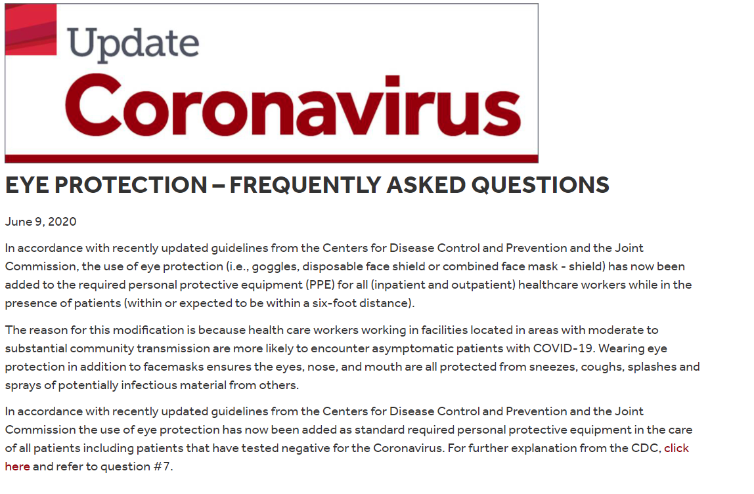
EYE PROTECTION

Slide 44
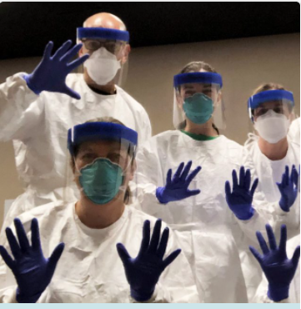
PPE

Slide 45
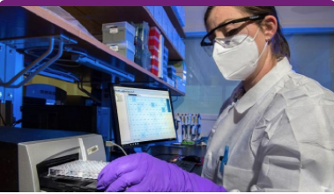
Personal Protective Equipment (PPE)
SBUH provides appropriate Personal Protective Equipment (PPE) to all employees as required by OSHA and the OSHA COVID ETS.
PPE includes, but is not limited to gloves, eye protection, and respirators.
Training, fit testing, and medical clearance may be needed for some PPE, in compliance with OSHA standards and SBUH policies.

Slide 46
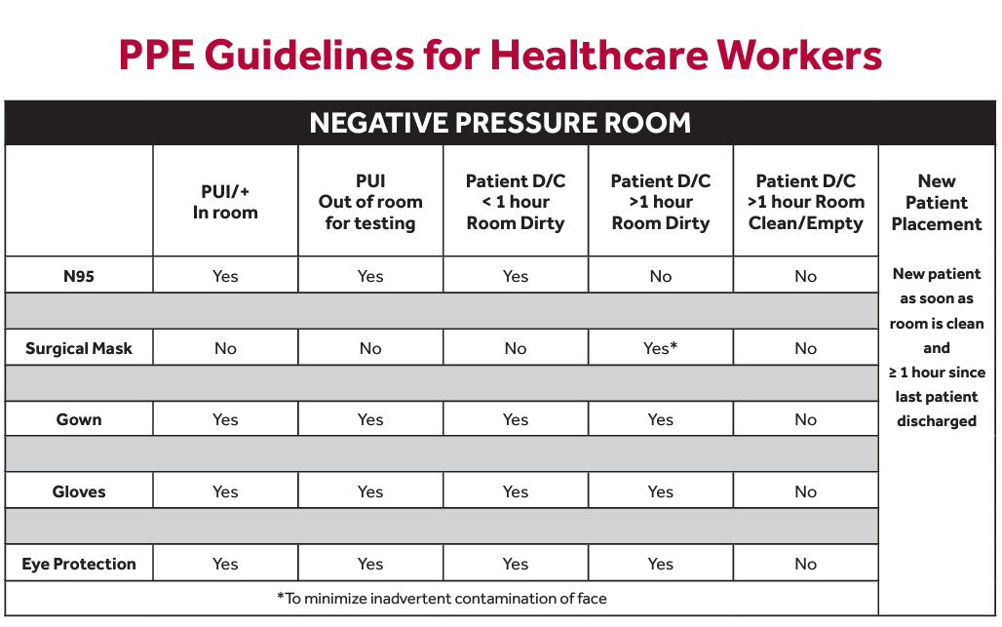

Slide 47
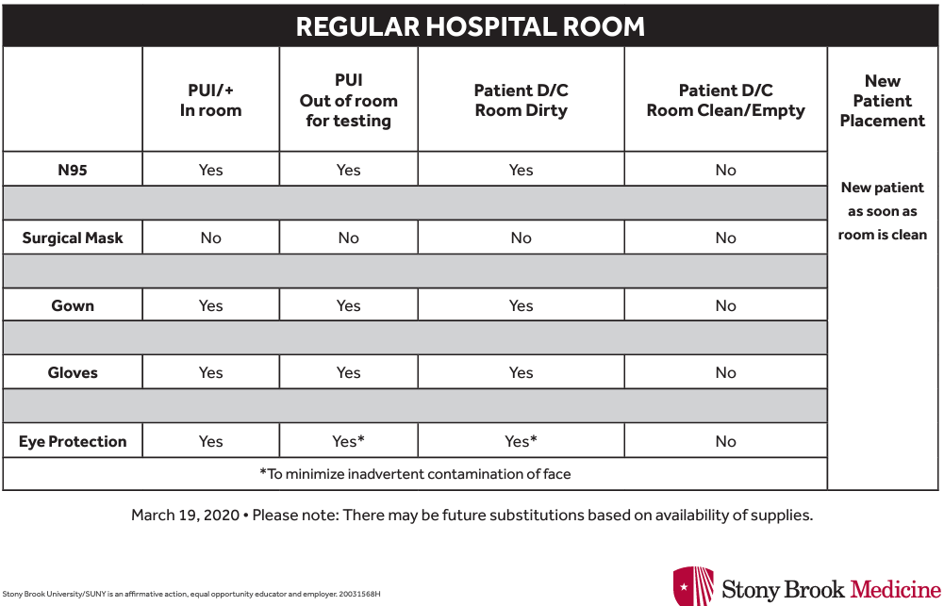

Slide 48
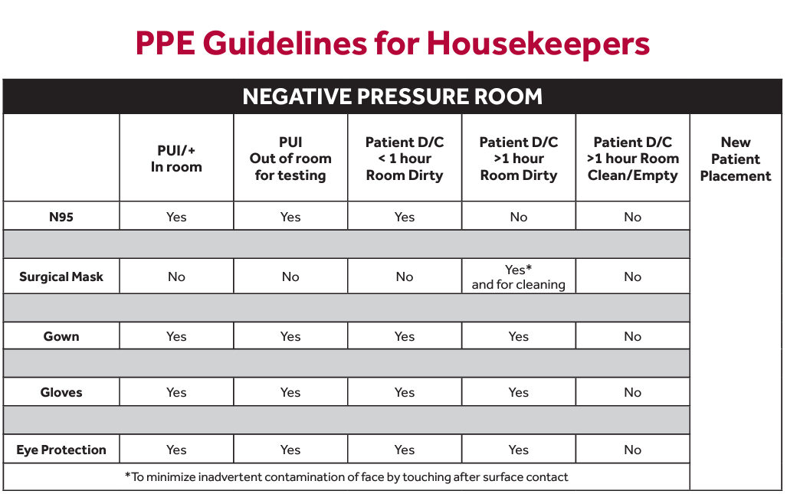

Slide 49
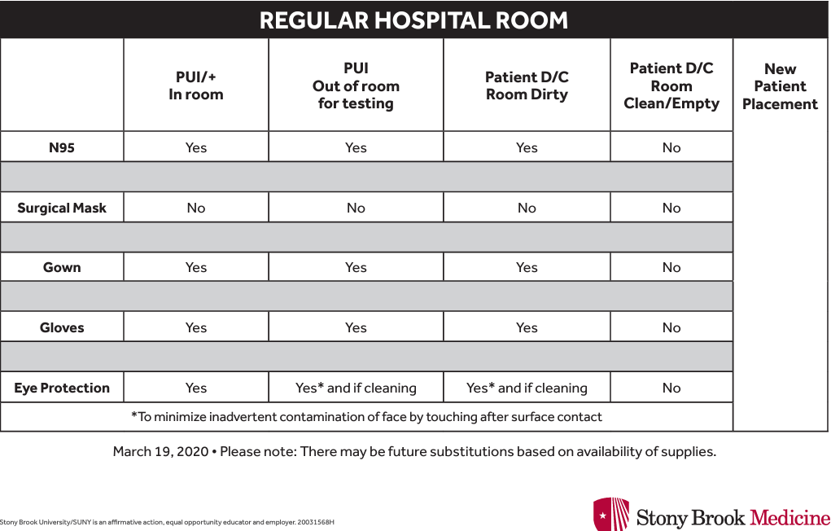

Slide 50
Respirators
Respirators are a type of personal protective equipment (PPE) certified by the National Institute for Occupational Safety and Health (NIOSH) or authorized under an FDA EUA.
Respirators protect against airborne hazards by:
Removing specific air contaminants from the surrounding air OR
Supplying breathable air from a safe source
Face coverings, facemasks, and face shields are not respirators.
Respirators can provide an additional level of comfort and protection for employees in circumstances that do not require a respirator to be used.
Your employer may provide a respirator to employees instead of a required facemask, and, in such cases, must comply with the ETS mini respiratory protection program (29 CFR 1910.504).
Continued

Slide 51
Respiratory Protection
For employees with exposure to people with suspected or confirmed COVID-19, SBUH provides respirators and other PPE, including gloves, an isolation gown or protective clothing, and eye protection. SBUH ensures respirators are used in accordance with the OSHA Respiratory Protection standard (29 CFR 1910.134) and Hospital policy EC0038 Respiratory Protection Program, and another PPE is used in accordance with OSHA’s PPE standards (29 CFR 1910 subpart I).

Slide 52
Stony Brook Hospital provides and ensures that employees use respirators and other PPE for exposure to people with suspected or confirmed COVID-19 and for aerosol-generating procedures. Respirator users are included in the Respiratory Protection Program, receive medical clearance and fit testing through Employee Health & Wellness, and are trained through Learning Management System (LMS). Supervisors are charged with enforcing appropriate PPE use.
Stony Brook Hospital provides respirators, goggles, and other PPE in accordance with their requirements based on standard transmission-based precautions.
See Personal Protective Equipment (PPE) Guidelines on ThePulse https://inside.stonybrookmedicine.edu/Coronavirus_what_you_need_to_know

Slide 53
Respirators
SBUH does not permit employee use of personal face masks or respirators.
SBUH permits the use of hospital-issued N95s for employees who are required to wear face masks but who request to use N95s (subject to availability). Such optional use is compliant with the mini-respirator provisions of the ETS (29 CFR 1910.504) or 29 CFR 1910.134, the traditional respiratory protection standard.
The use of personal N95s is not permitted.

Slide 54
Aerosol-Generating Procedures (AGP)
When an AGP is performed on a person with suspected or confirmed COVID-19, your employer must:
Provide a respirator and other PPE (see previous slides).
Limit the number of employees present during the procedure to only those essential for patient care and procedure support.
Ensure that the procedure is performed in an existing airborne infection isolation room (AIIR), if available.
Promptly clean and disinfect the surfaces and equipment in the room or area where the procedure was performed, after the procedure is completed.

Slide 55
AGP – Aerosol Generating Procedures
Perform AGPs on persons with suspected or confirmed COVID-19 in an airborne infection isolation room, if available; limit employees present to only those essential; and clean and disinfect surfaces and equipment promptly after the procedure is completed.
See ThePulse for procedures for AGPs.
https://inside.stonybrookmedicine.edu/Coronavirus/New_Bedside_Procedures_COVID-19_Patient

Slide 56
AGPs
AGPs performed within a patient’s room include: nebulizer treatments; open suctioning; spirometry; endoscopy/bronchoscopy; chest tube insertion; intubation/extubation; and examination of the upper airway.
Full PPE – gowns, gloves, eye protection and N95.
Full PPE is also required when entering the room of patients possessing an open tracheostomy/laryngectomy stoma or using a BIPAP or CPAP mask, high flow mask or high flow nasal cannula – all of which are considered continuous ongoing sources of aerosol generation.
For room turnovers and additional details please see:
https://inside.stonybrookmedicine.edu/Coronavirus/New_Bedside_Procedures_COVID-19_Patient

Slide 57
See ThePulse for procedures for AGPs.
https://inside.stonybrookmedicine.edu/Coronavirus/New_Bedside_Procedures_COVID-19_Patient

Slide 58
Physical Distancing
SBUH ensures that each employee is separated from all other people in the workplace by at least 6 feet when indoors unless it can be demonstrated that such physical distance is not feasible for a specific activity.
Where maintaining 6 feet of physical distance is not feasible, SBUH ensures employees are as far apart from other people as possible. Physical distancing is implemented, along with the other provisions required by OSHA’s COVID-19 ETS, as part of a multi-layered infection control approach.

Slide 59
Physical Barriers
SBUH installs physical barriers at each fixed work location outside of direct patient care areas where each employee is not separated from all other people by at least 6 feet of distance, and spacing cannot be increased unless it can be demonstrated that it is not feasible to install such physical barriers. Physical barriers are implemented, along with the other provisions required by OSHA’s COVID-19 ETS, as part of a multi-layered infection control approach.
SBUH provides cleanable solid barriers at each work location in non-patient care areas where each employee is not separated from other people by at least 6 feet unless mask-wearing is enforced.
Continued

Slide 60
Where employees cannot be provided with 6 feet of distance from all other persons in the workplace, physical barriers are used. Mask wearing may also be required.
Signage, including flow, is provided throughout the facility and adjusted as necessary to ensure physical distancing.
In some cases, occupancy is reduced through temporary moves, rearrangement of work stations, work from alternate locations assignments, flexible/staggered hours. All such actions are fully compliant with the Governor’s Office of Employee Relations direction.

Slide 61
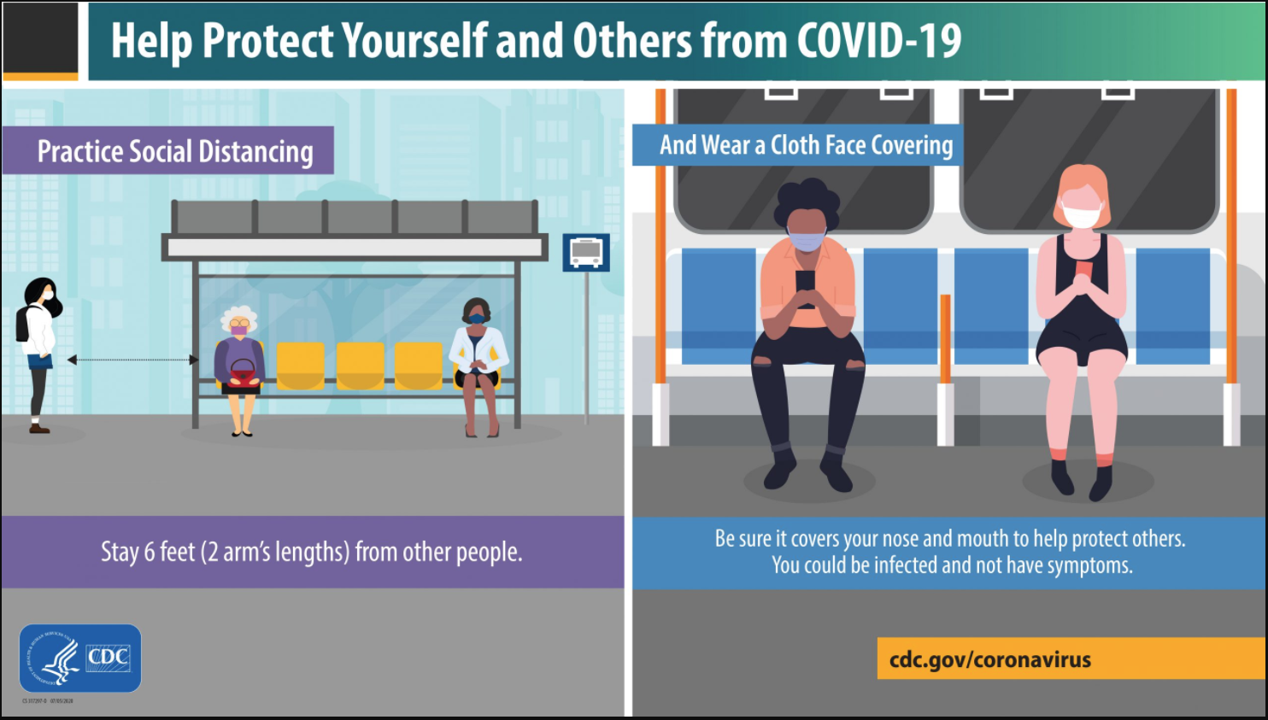

Slide 62
Cleaning and Disinfection
SBUH implements policies and procedures for cleaning, disinfection, and hand hygiene, along with the other provisions required by OSHA’s COVID-19 ETS, as part of a multi-layered infection control approach.
SBUH implements cleaning and disinfecting protocols in patient care areas consistent with guidance provided by cognizant authorities, including the CDC and NYS Department of Health (DOH), implemented with the support of Healthcare Epidemiology. In all areas, high-touch surfaces and equipment are frequently cleaned. Alcohol-based hand sanitizer (minimum 60% alcohol) and handwashing facilities are readily available throughout the facility, and their use is strongly encouraged. See IC0003 Hand Hygiene.

Slide 63
In patient care areas, resident rooms, and for medical devices and equipment:
SBUH follows standard practices for cleaning and disinfection of surfaces and equipment in accordance with CDC’s “COVID-19 Infection Prevention and Control Recommendations” and CDC’s “Guidelines for Environmental Infection Control.”
See also IC0013 Patient Care Equipment Cleaning.

Slide 64
In all other areas:
SBUH requires the cleaning of high-touch surfaces and equipment at least once a day, following manufacturers’ instructions for the application of cleaners.
When a person who is COVID-19 positive has been in the workplace within the last 24 hours, SBUH requires cleaning and disinfection, in accordance with CDC’s “Cleaning and Disinfecting Guidance,” of any areas, materials, and equipment that have likely been contaminated by that person (e.g., rooms they occupied, items they touched).
SBUH provides alcohol-based hand rub that is at least 60% alcohol or provides readily accessible handwashing facilities. In addition, signs are posted encouraging frequent handwashing and the use of hand sanitizers.

Slide 65
Ventilation
SBUH has reviewed its HVAC (air handling) system and confirmed its operation is generally within the manufacturers’ instructions and design specifications. Filtration has been improved in response to COVID and filters are rated MERV-13 or higher, and outdoor air intake has been increased. Airborne Infection Isolation Rooms are maintained and operated appropriately. Intakes are cleaned, maintained, and cleared of debris.

Slide 66
SBUH has implemented policies and procedures for each facility’s heating, ventilation, and air conditioning (HVAC) system and ensures that:
The HVAC system(s) is used in accordance with the manufacturer’s instructions and the design specifications of the HVAC system(s);
The amount of outside air circulated through the HVAC system(s) and the number of air changes per hour are maximized to the extent appropriate;
All air filters are rated Minimum Efficiency Reporting Value (MERV) 13 or higher, if compatible with the HVAC system(s); if not compatible, the filter with the highest compatible filtering efficiency is used;
All air filters are maintained and replaced as necessary to ensure the proper function and performance of the HVAC system;
All intake ports that provide outside air to the HVAC system(s) are cleaned, maintained, and cleared of any debris that may affect the function and performance of the HVAC system(s); and
Existing airborne infection isolation rooms (AIIRs), if any, are maintained and operated in accordance with their design and construction criteria.

Slide 67
Coordination with Other Employers
SBUH communicates COVID-19 plans and procedures with all other employers that share the same worksite and will coordinate with each employer to ensure that all workers are protected. SBUH adjusts this COVID-19 plan to address any particular hazards presented by employees of other employers at the worksite. Other employer employees are addressed by the University P601 Guests/Visitors Policy, which includes:

Slide 68
Stony Brook University is committed to providing a safe and lawful environment for its students, faculty, staff, volunteers, and guests/visitors (which includes minors). This policy includes specific rules and procedures which must be followed by students, faculty, staff, volunteers, and guests/visitors, regardless of the length of their visit.
All guests/visitors and volunteers are required to adhere to all Stony Brook University policies and procedures and must comply with all applicable federal, state, and local laws.
All visitors are required to follow programs, including masking and social distancing, in place at the time of their visit. This includes all non-staff and non-patients.

Slide 69
Requirements implemented at no cost to employees
SBUH complies with the provisions of OSHA’s COVID-19 ETS at no cost to its employees, with the exception of any employee self-monitoring conducted under the Health Screening and Medical Management section of this Plan.

Slide 70
Anti-Retaliation
SBUH informs employees that employees have a right to the protections required by OSHA’s standards, which include COVID-19 ETS, and that employers are prohibited from discharging or in any manner retaliating or discriminating against any employee for exercising their right to protections required by OSHA or for engaging in actions that are required by OSHA. SBUH does not discharge or in any manner discriminate against any employee for exercising their right to the protections required by OSHA or for engaging in actions that are required by OSHA, including OSHA’s COVID-19 ETS.

Slide 71
Additional Training and How to Obtain More Information
SBUH implements policies and procedures for employee training, along with the other provisions required by OSHA’s COVID-19 ETS, as part of a multi-layered infection control approach. SBUH’s COVID-19 training program is accessible in the following ways: departmental/unit meetings, ThePulse, LMS, orientations and recertifications, Putting Safety First and Morning Huddle meetings, and other meetings and events.
SBUH developed a robust online training module at the onset of the pandemic on the plan to keep employees healthy and safe throughout the COVID-19 pandemic. This educational model was assigned to all SBUH employees. In addition, and in accordance with a recent NY State directive, all employees will be required to read health and safety protocols related to COVID-19 and affirm they will adhere to them. Ongoing education is delivered to employees in various forums, which include but are not limited to staff meetings, daily huddles, email blasts, and the hospital intranet.

Slide 72
Stony Brook Medicine Quick Links
https://inside.stonybrookmedicine.edu/Coronavirus/SBM_quick_links

Slide 73
COVID-19 Plan Safety Coordinator
The ETS requires the designation of a COVID-19 Plan Safety Coordinator, who must:
Implement the COVID-19 plan.
Monitor the effectiveness of COVID-19 plan.
Be knowledgeable in infection control principles and practices as they apply to the workplace and employee job operations.
Ensure compliance with all aspects of the COVID-19 plan.
SBUH
COVID-19 Plan Safety Coordinator(s)
Name: Jennifer Maxwell
Email: Jennifer.Maxwell@stonybrookmedicine.edu
Phone: 631 444 2646

Slide 74
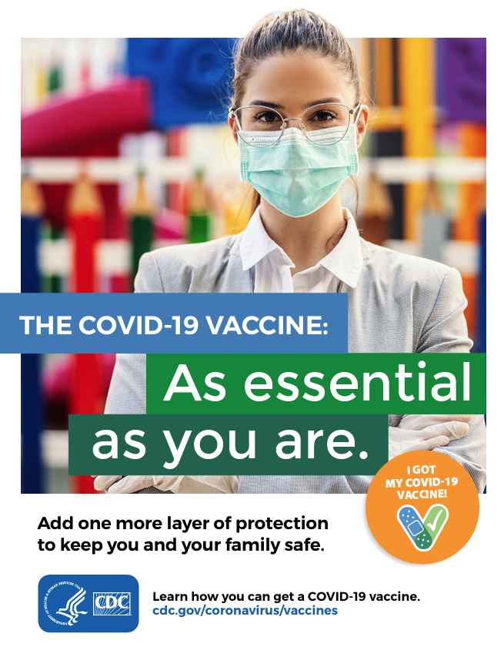

Slide 75
More Information
osha.gov/coronavirus

